Slide 1
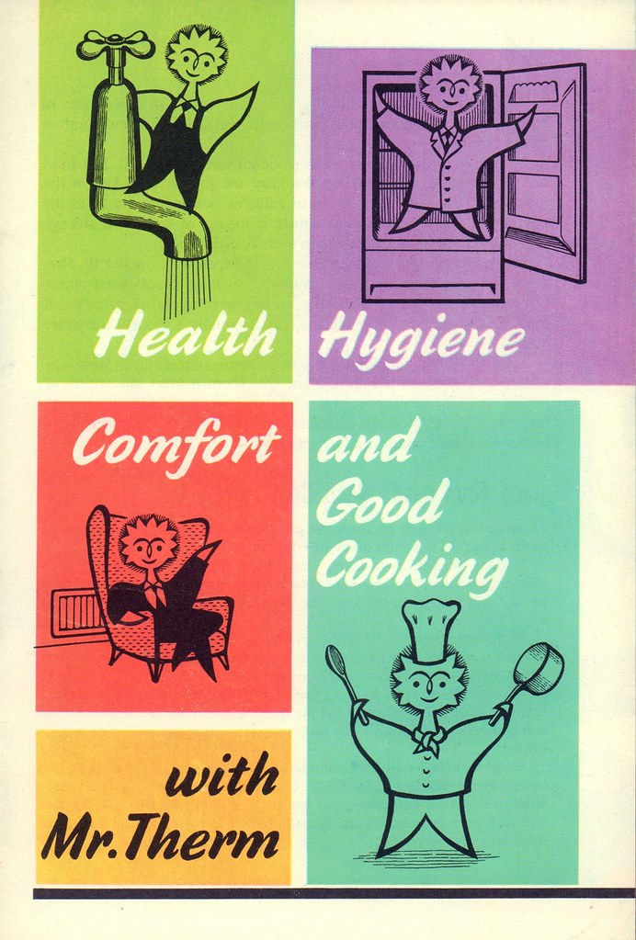
HYGIENE
CLEANLINESS IS GODLINESS
tabassum

Slide 2

Content
Introduction
Difference between hygienic and unhygienic
Types of hygiene
Environmental hygiene
Personal hygiene
Domestic hygiene
Food hygiene
Query
Thank you

Slide 3
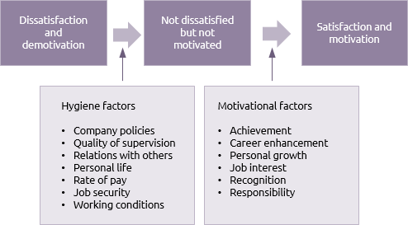
WHAT IS HYGIENE?
Hygiene refers to behaviors that can improve cleanliness and lead to good health, such as frequent handwashing, facial cleanliness, and bathing with soap and water.

Slide 4
DIFFERENCE BETWEEN HYGIENE AND UNHYGIENE
HYGIENE
UNHYGIENE
If you describe something as unhygienic, you mean that it is dirty and likely to cause infection or disease.
Hygienic refers to practices that cleanliness and good health,
while unhygienic refers to practices that are unsanitary or promote poor health.

Slide 5
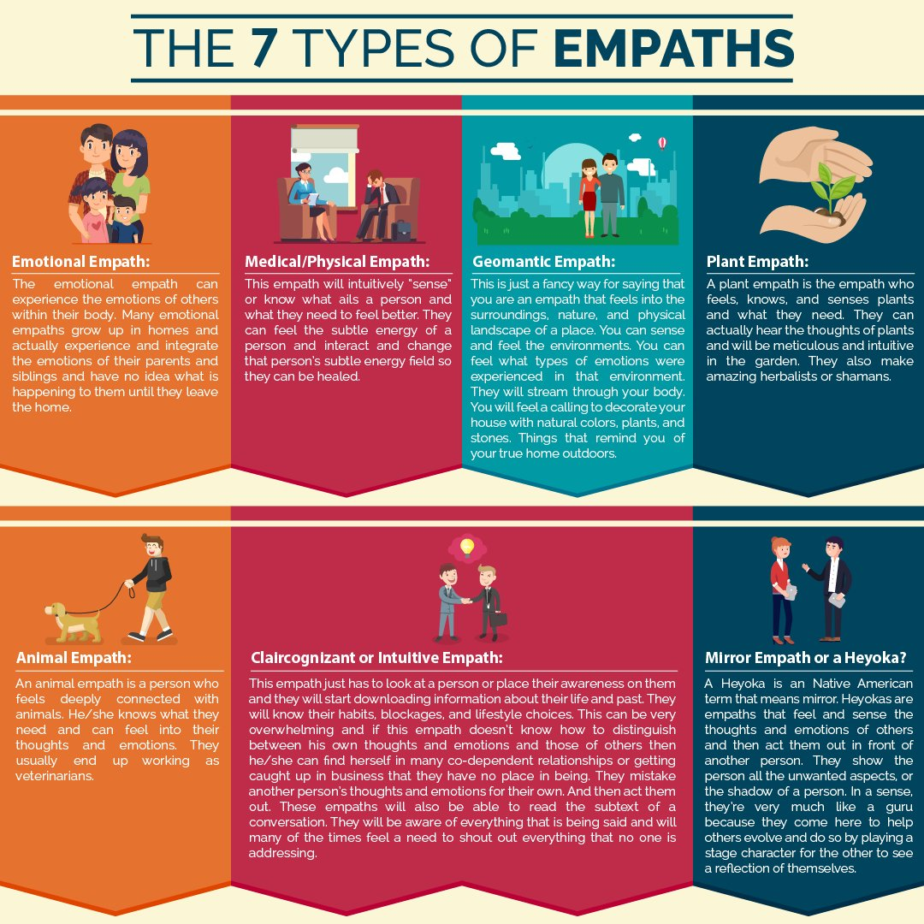
TYPES OF HYGIENE
What are the types of hygiene?
Environmental Hygiene.
Personal hygiene.
Domestic hygiene.
Food hygiene.
This Photo by Unknown Author is licensed under CC BY-NC

Slide 6
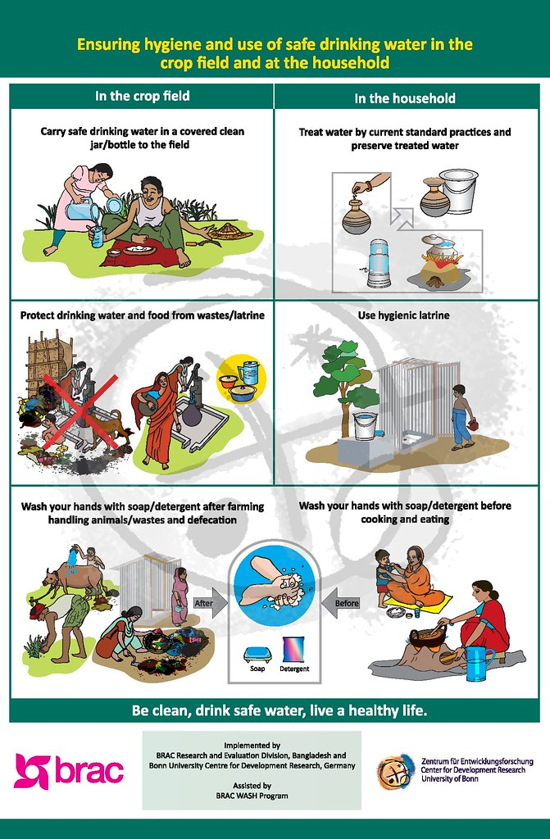
Environmental hygiene
Environmental hygiene encompasses effective cleaning of surfaces using appropriate products, decontamination of medical equipment and devices used in patient-care procedures, safe and appropriate handling of sharps, blood and body fluid spills, waste and linen.

Slide 7
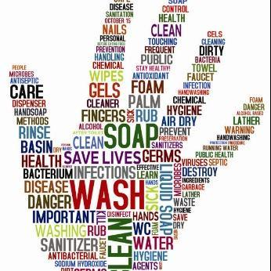
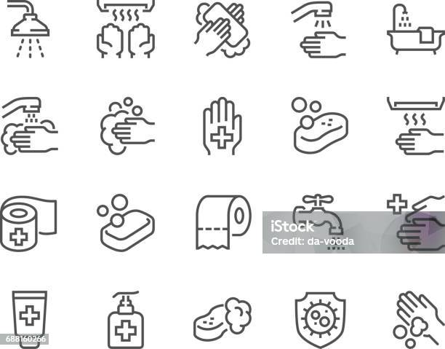

PERSONAL HYGIENE

Slide 8
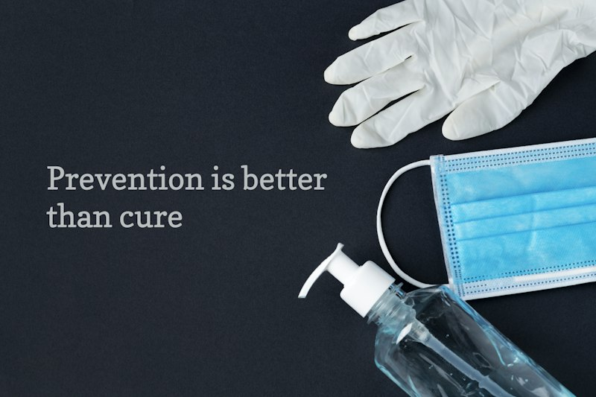
PERSONAL HYGYINE
Personal hygiene includes: cleaning your body every day. washing your hands with soap and water after going to the toilet. brushing and flossing your teeth twice a day. covering your mouth and nose with a tissue (or your sleeve) when sneezing or coughing.

Slide 9
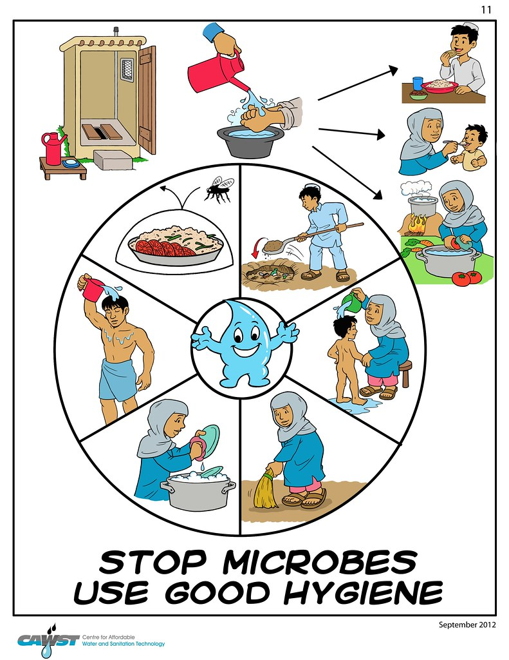
Domestic hygiene
Domestic hygiene which involves cleanliness, the sanitary preparation of food, and ventilation, generally means cleanliness in homes. Domestic hygiene practices include all the work done to keep people's clothes, beddings, and houses clean.
This Photo by Unknown Author is licensed under CC BY

Slide 10
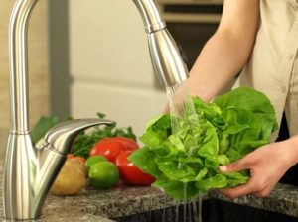
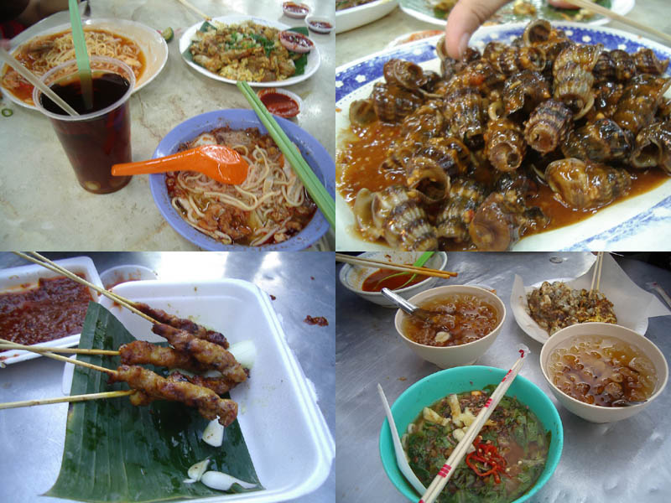
HYGENIC FOOD AND UNHYGIENIC FOOD HYGIENIC UNHYGIENIC
This Photo by Unknown Author is licensed under CC BY-SA-NC

Slide 11
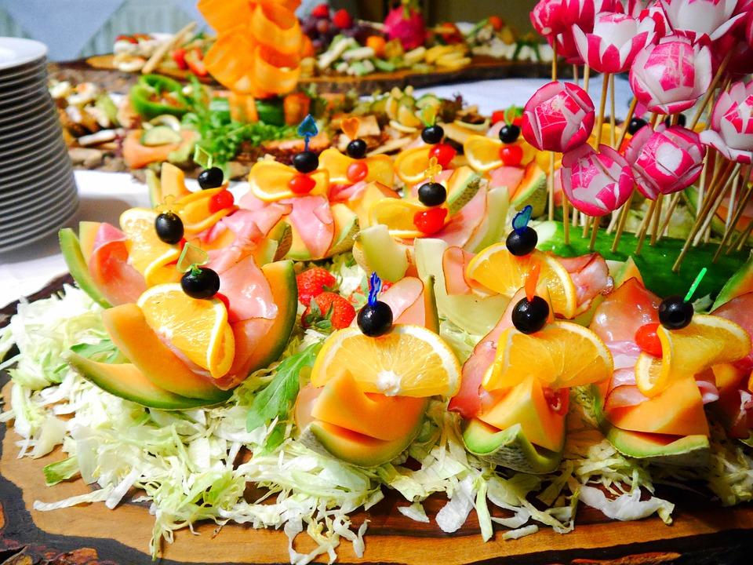

About food
HYGIENIC FOOD
Food hygiene is relevant to everyone working in the food industry, including the distribution of food, selling food, producing, processing, storing or retailing food.
UNHYGIENIC FOOD
Unhygienic conditions include: lack of hand washing between handling raw and cooked foods. unclean surfaces

Slide 12
QUERY ?

Slide 13
THANK YOU

